Slide 1
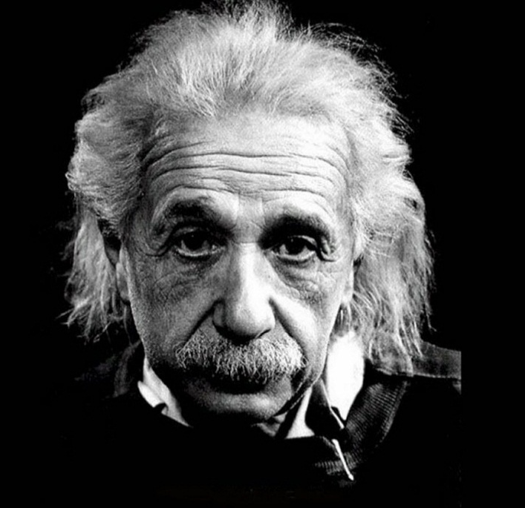
PHYS 2210
Lecture # 1
Vern Hart PhD
vhart@uvu.edu
“Place your hand on a hot stove for a minute and it seems like an hour, sit with a pretty girl for an hour and it seems like a minute. That is relativity.”
-Albert Einstein

Slide 2
Physics
Who
How
Where
Why
When
What

Slide 3
Physics
What?

Slide 4
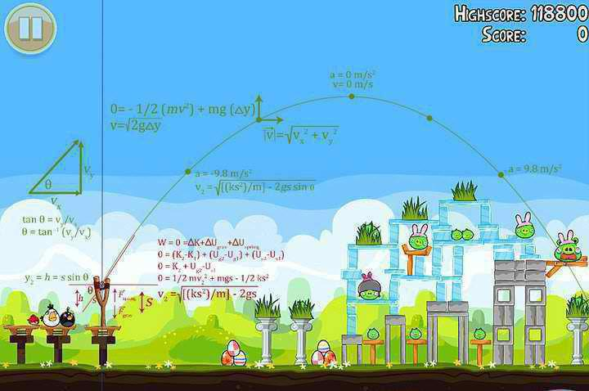
Motion

Slide 5
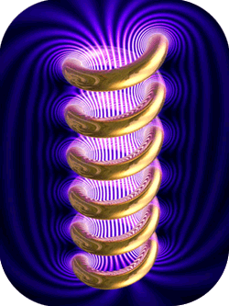
Electromagnetism

Slide 6
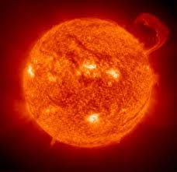
Thermodynamics

Slide 7
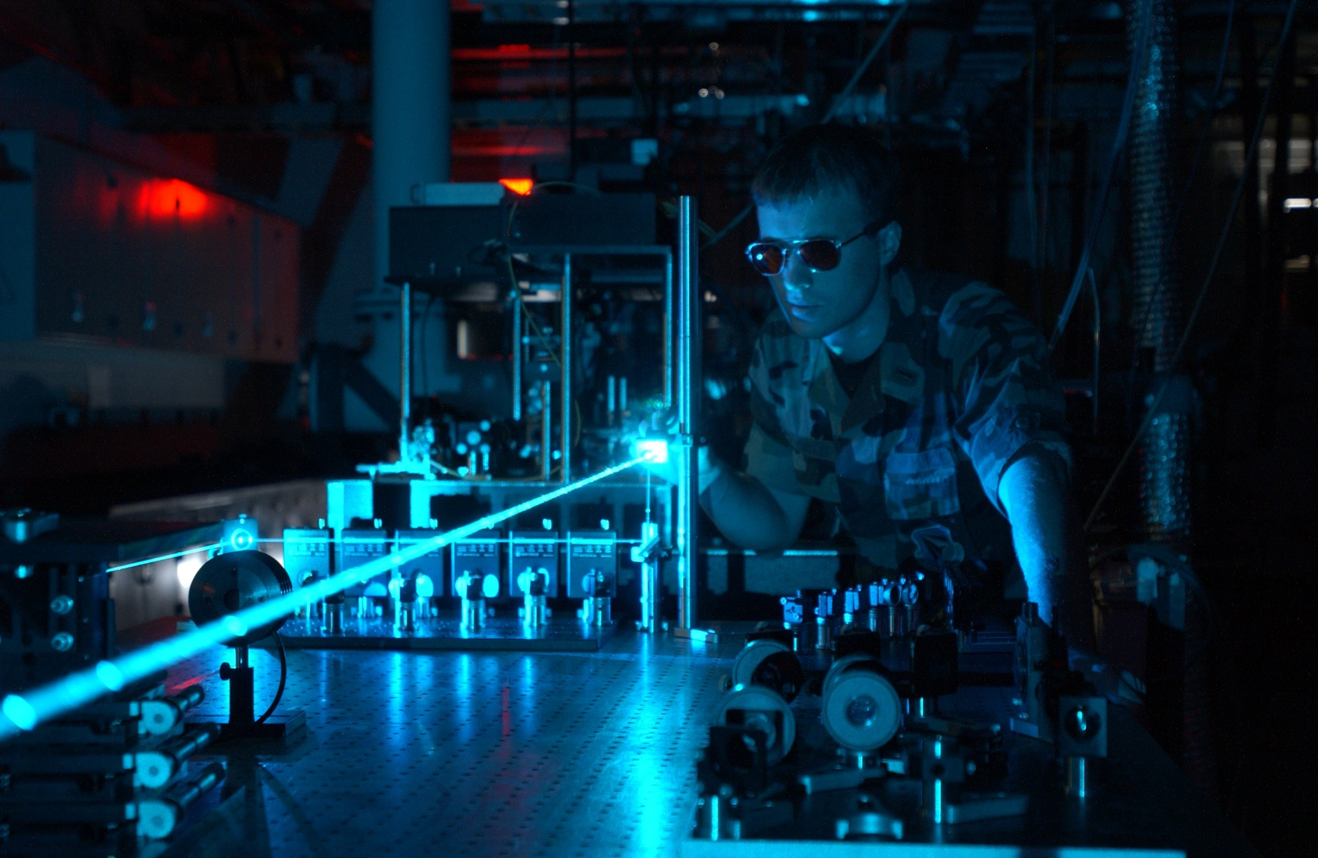
Optics

Slide 8

Nuclear Physics

Slide 9
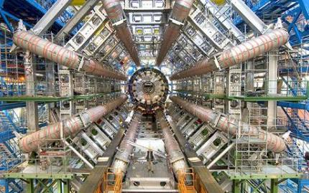
Particle Physics
http://www.cyriak.co.uk/lhc/lhc-webcams.html

Slide 10
3 Realms
Classical
Relativistic
Modern
Quantum
http://htwins.net/scale2/index.html

Slide 11
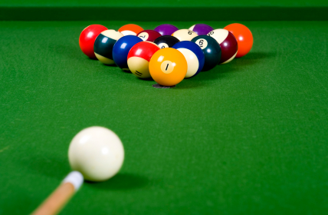
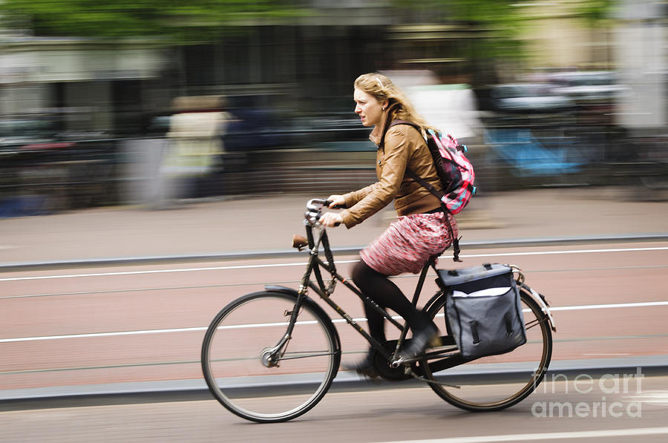
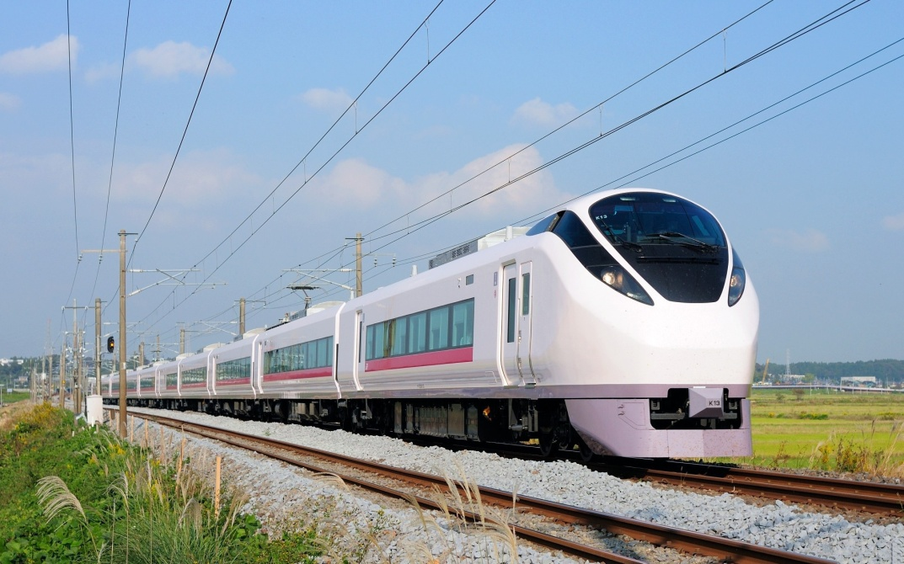
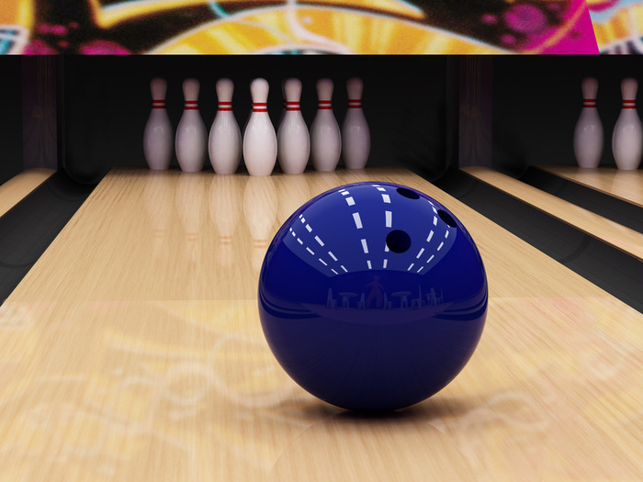

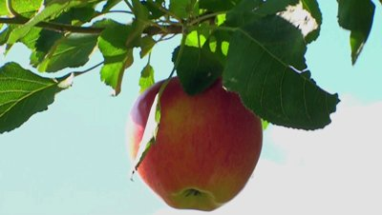
Classical
“Slow” <100,000,000 mph
Medium-Sized
~10⁻⁶ -10⁶ m

Slide 12
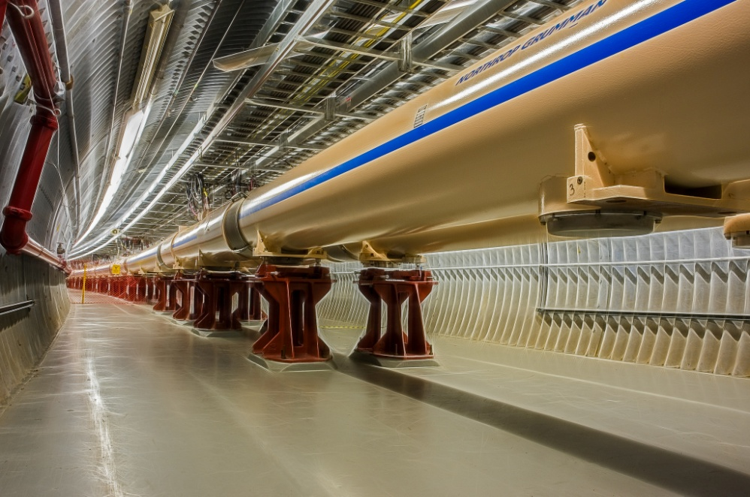
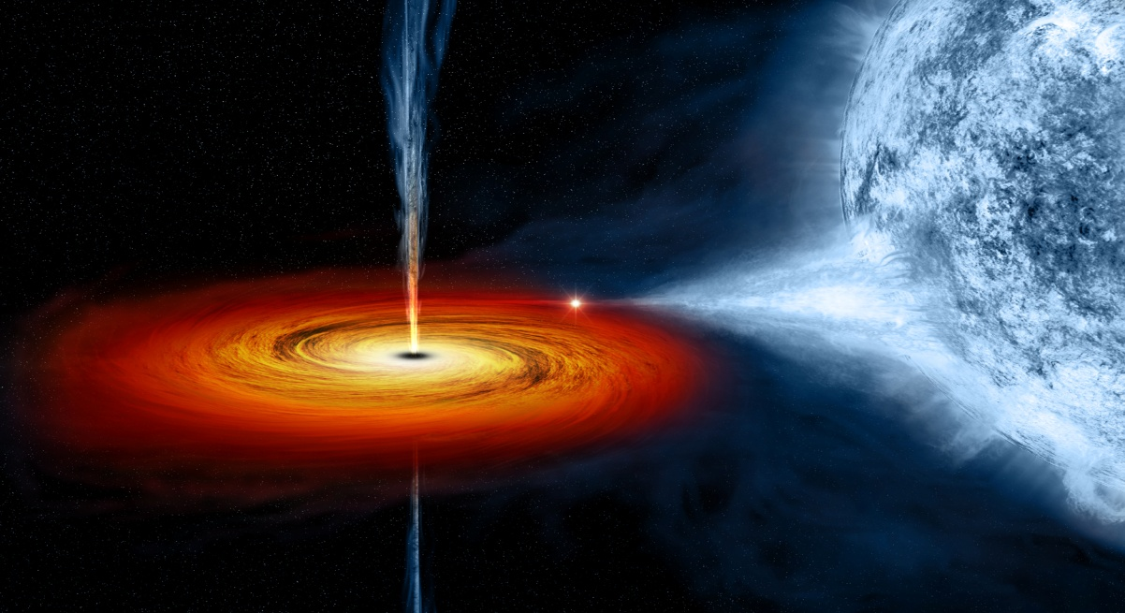
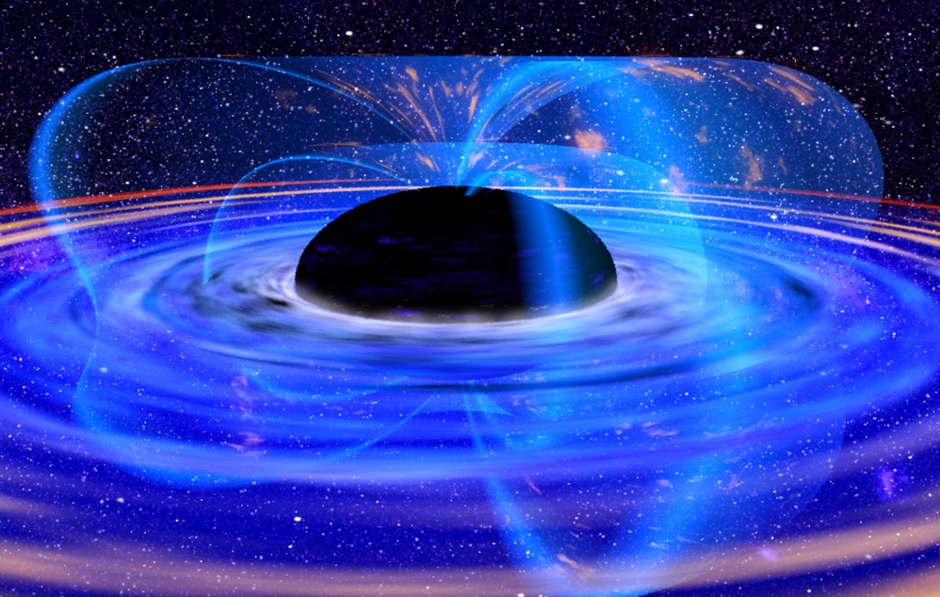
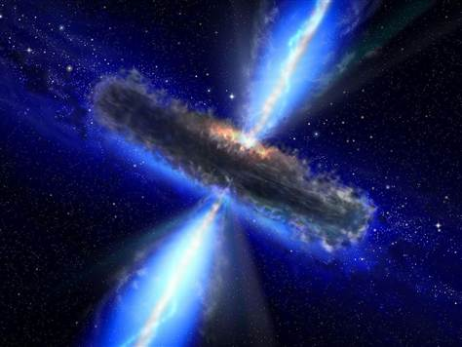
Relativistic
Fast Things >100,000,000 mph
Big Things
>10⁶ m

Slide 13
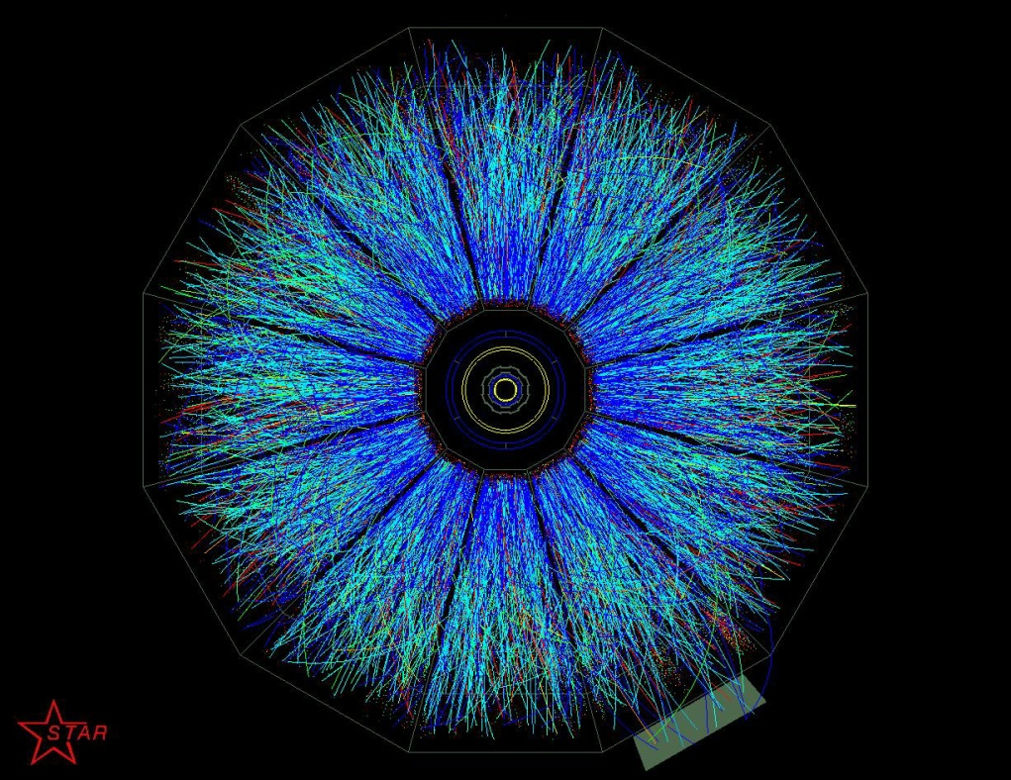
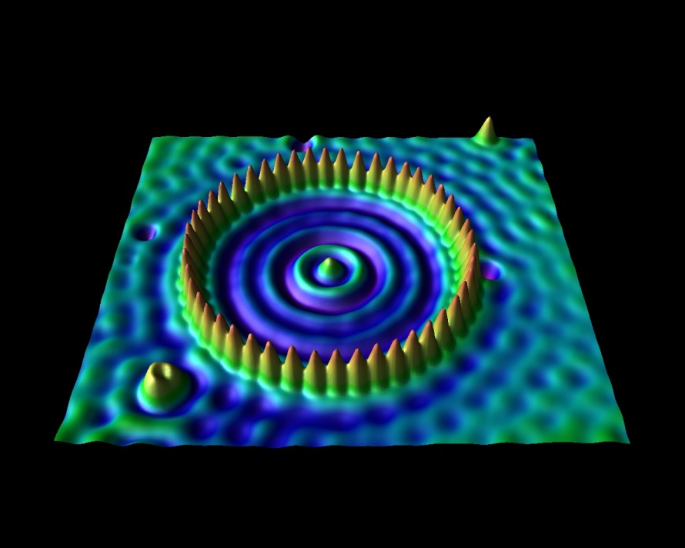
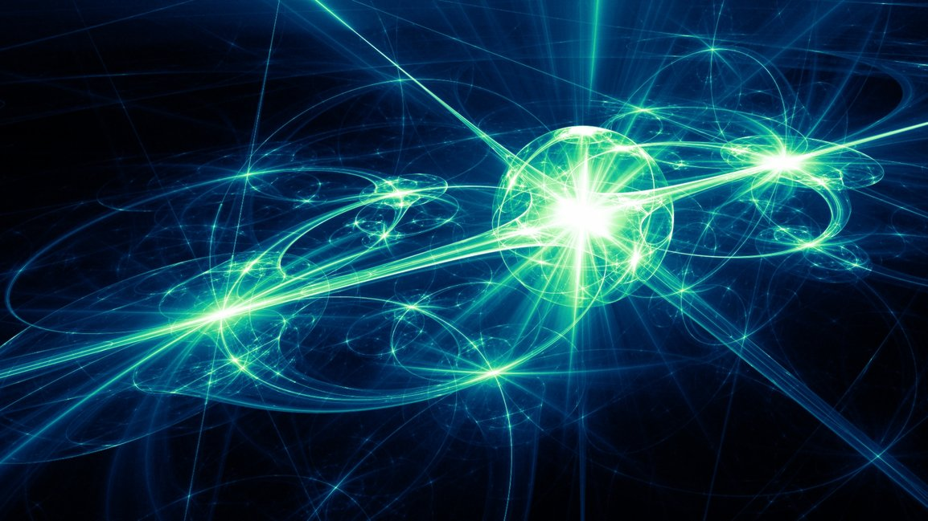
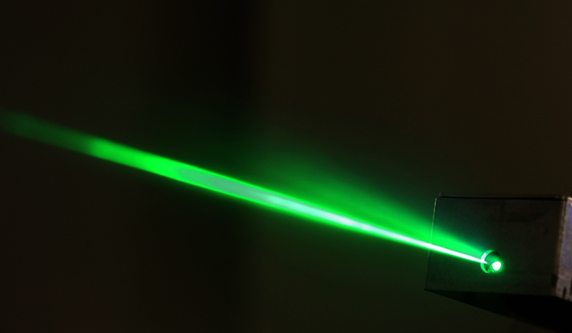
Quantum
Energetic Things >1,000,000 Mev
Small Things
<10⁻⁶ m

Slide 14
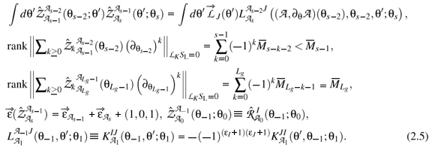
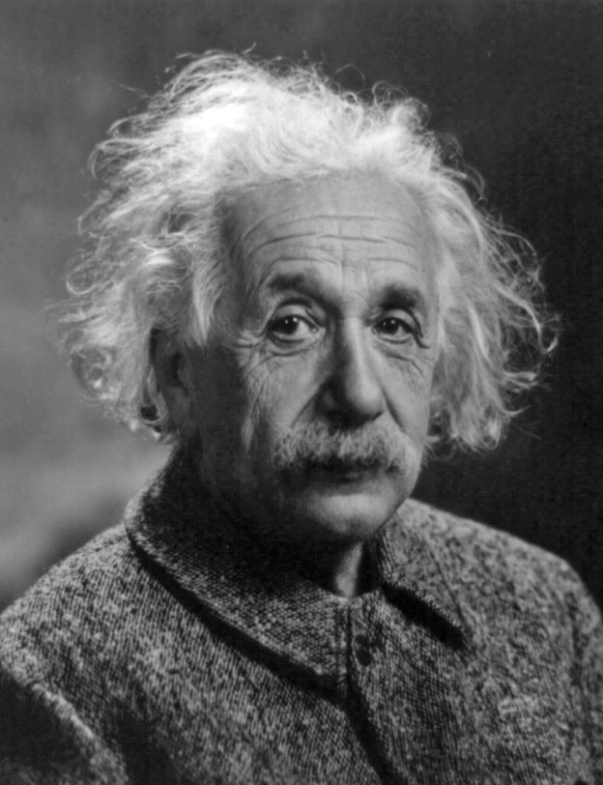
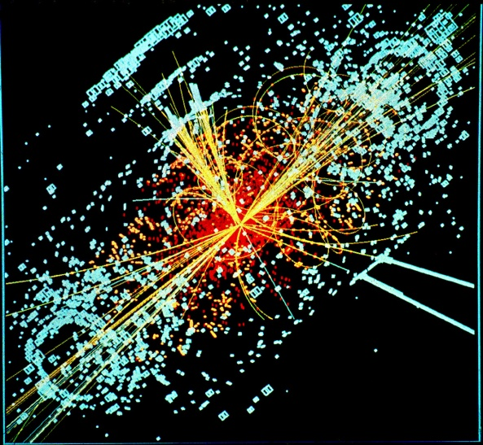
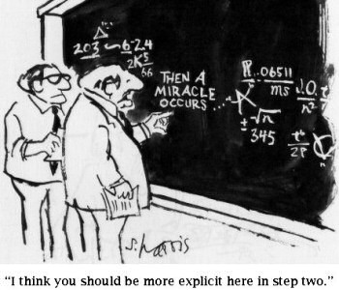
Grand Unified Theory
GUT

Slide 15
Physics is the study of…
Energy

Slide 16
Physics
Who?

Slide 17
All the cool scientists

Slide 18
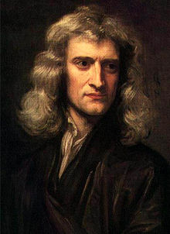
Isaac Newton

Slide 19
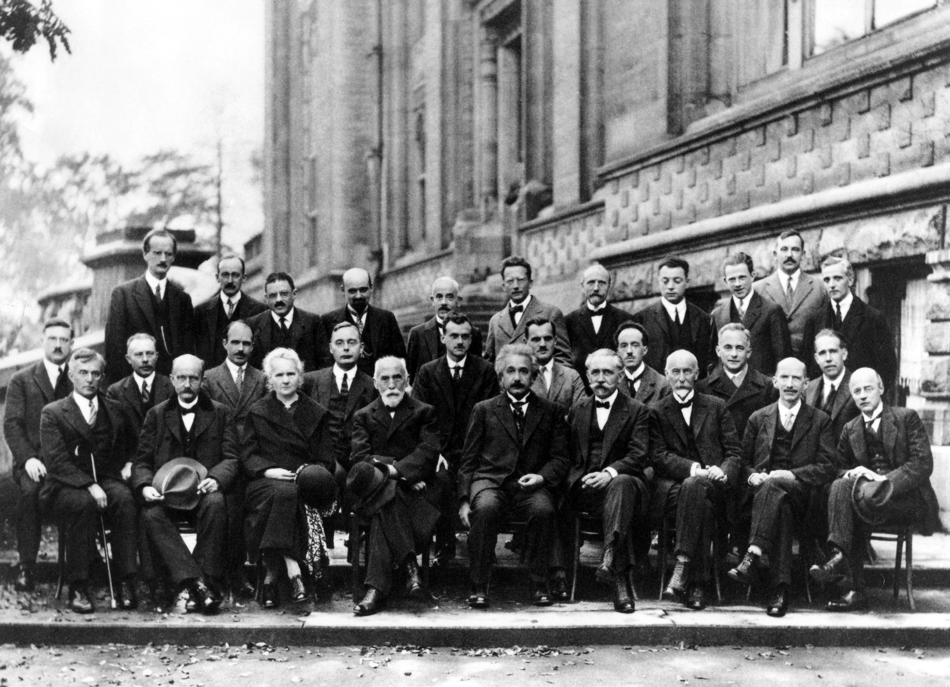
The Solvay Conference
History’s most impressive photograph

Slide 20
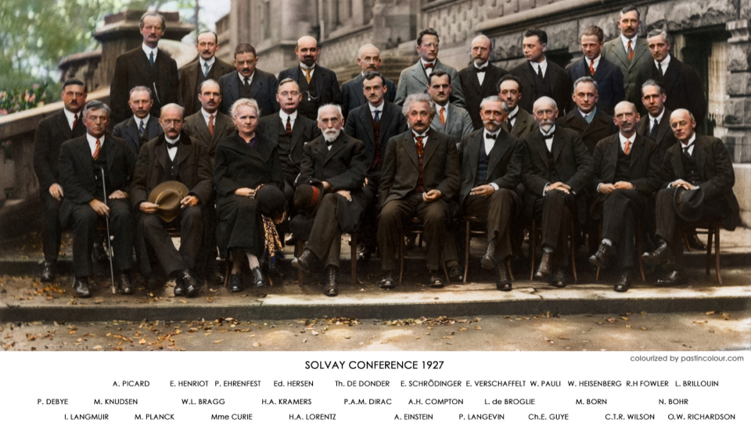
Paul Ehrenfest
Erwin Schroedinger
Wolfgang Pauli
Werner Heisenberg
William Bragg
Paul Dirac
Arthur Compton
Louis De Broglie
Max Born
Max Planck
Marie Curie
Hendrik Lorentz
Albert Einstein
Niels Bohr

Slide 21
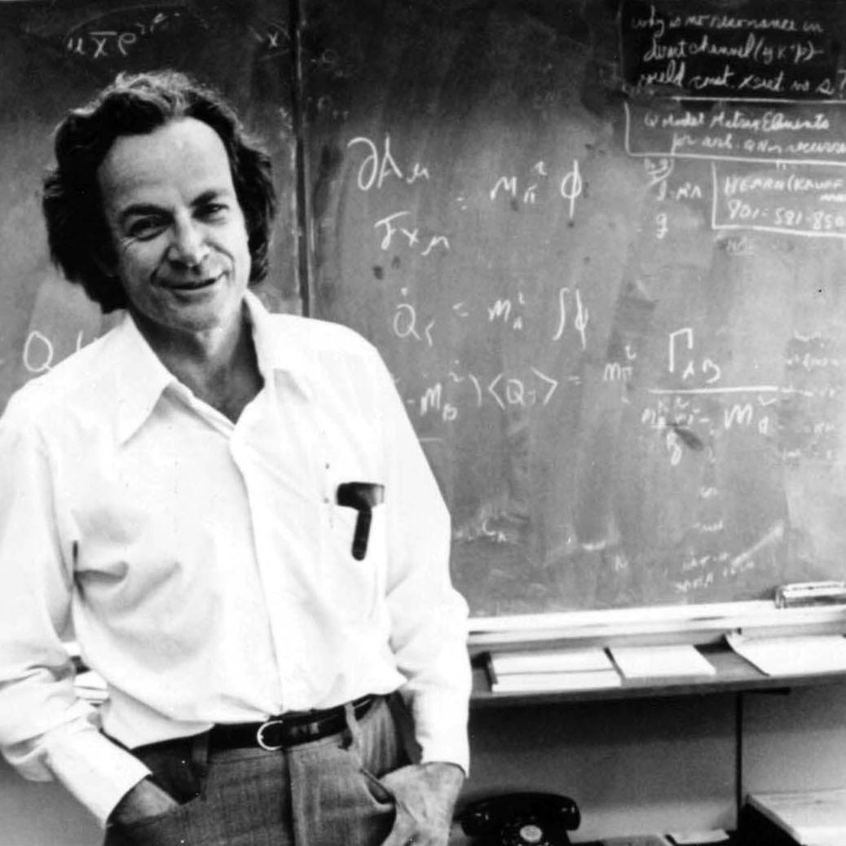
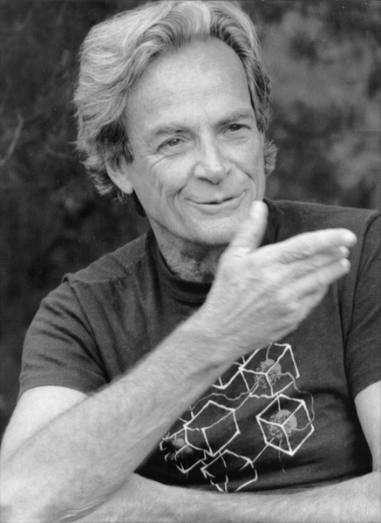
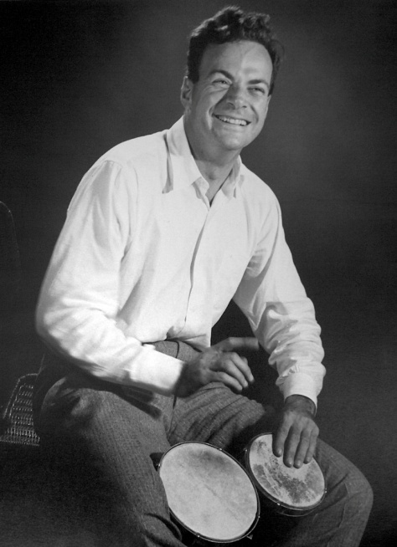
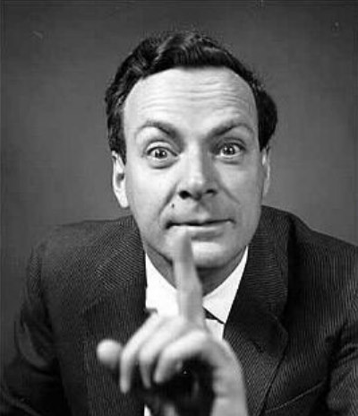
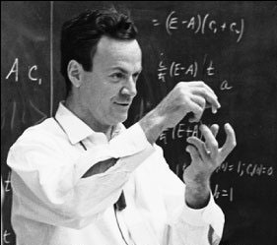
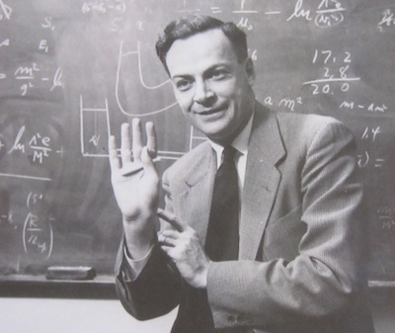
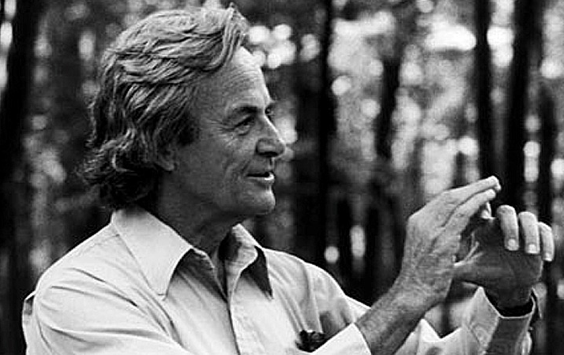
Also…
Richard Feynman

Slide 22
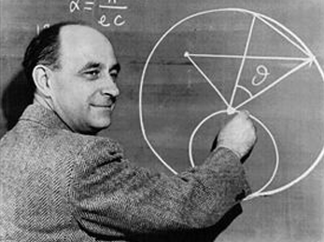
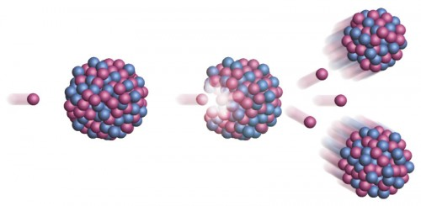
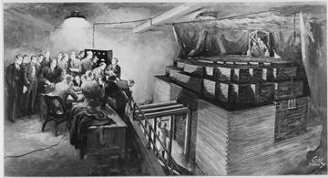
Enrico Fermi
Split the atom

Slide 23
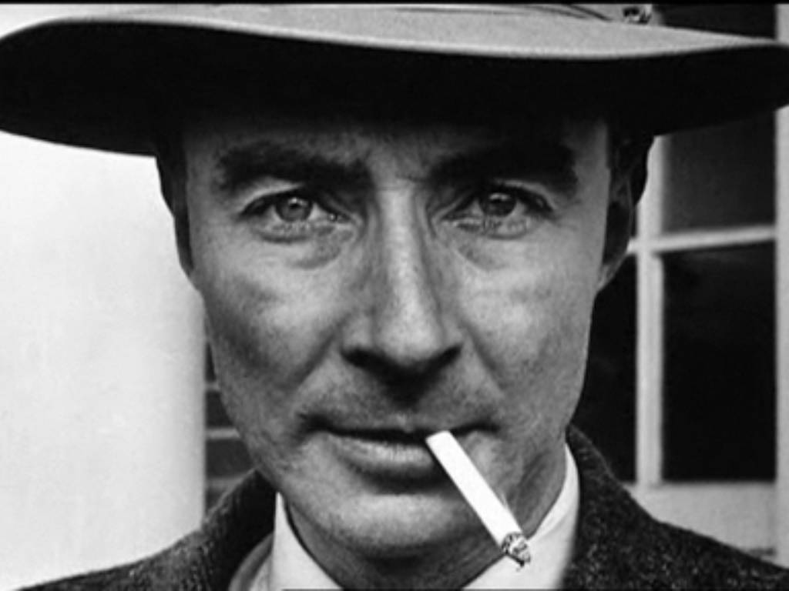
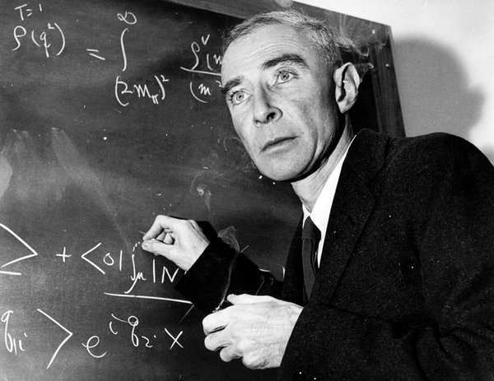
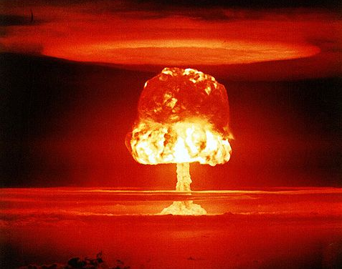
Robert Openheimer
Atomic Bomb

Slide 24
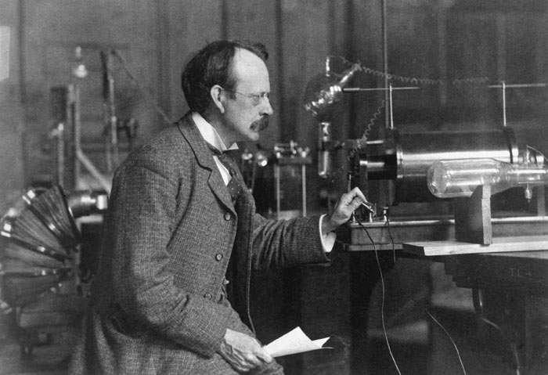
JJ Thomson
electrons

Slide 25
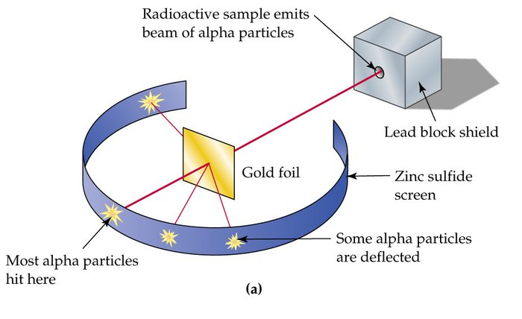
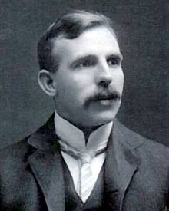
“Physics is the queen science, all else is merely stamp collecting.”
Ernest Rutherford

Slide 26
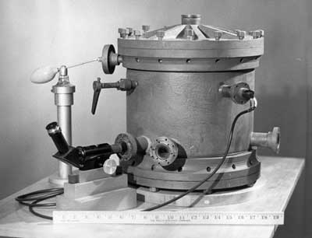
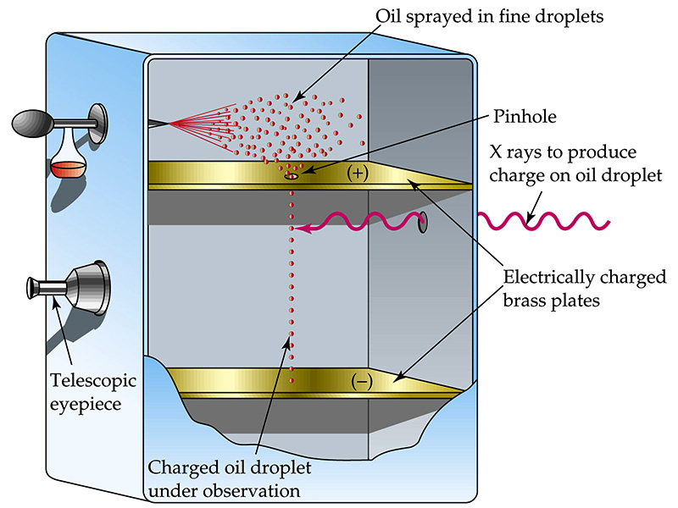
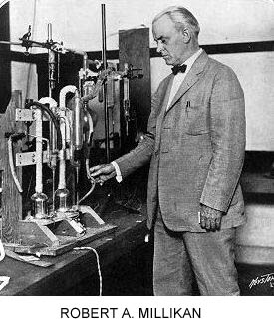
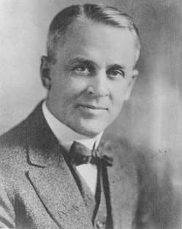
Robert Milikan
Oil Drop

Slide 27
Physics
Where?

Slide 28
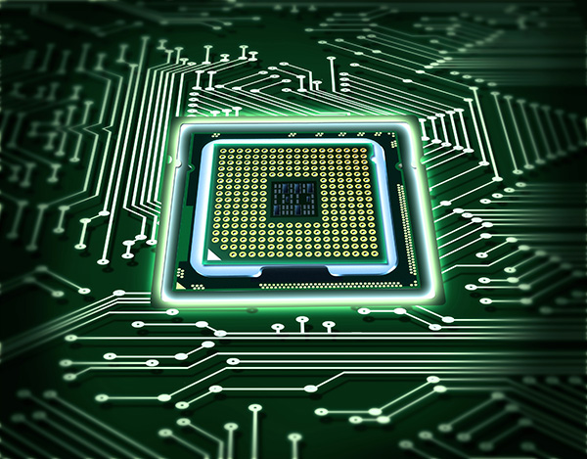
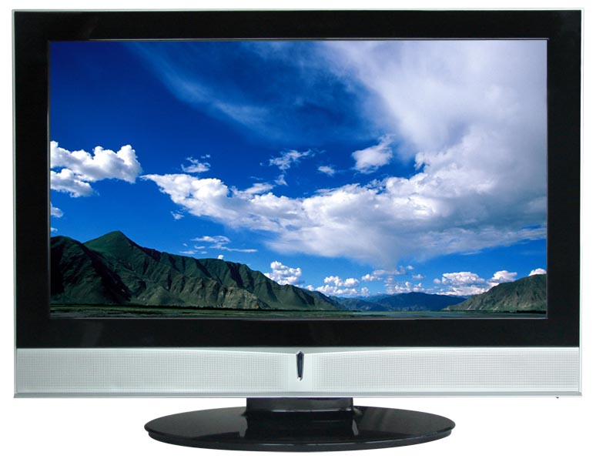


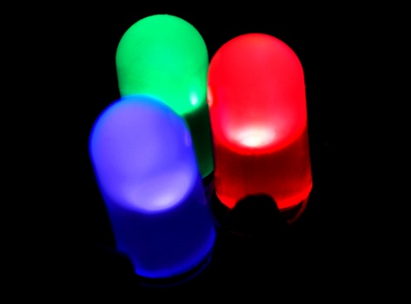
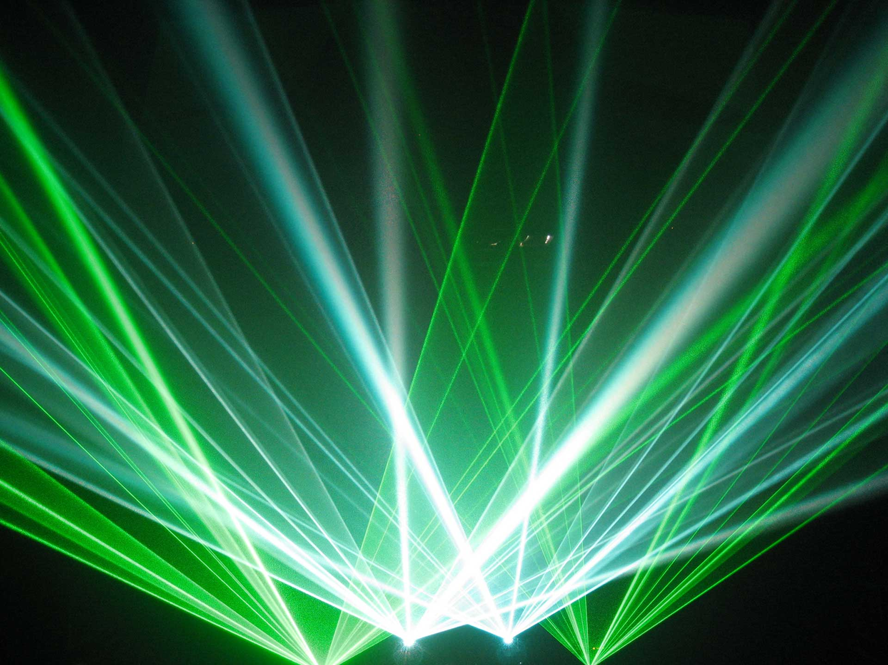

Everywhere

Slide 29
Physics
How?

Slide 30

Natural Philosophy

Slide 31


The Scientific Method
Observe
Hypothesize
Model
Test
Analyze
Predict

Slide 32


Slide 33
Physics
Why?

Slide 34
Because it’s freaking awesome

Slide 35
Units
The SI system:
Distance –
Mass –
Time –
m
kg
s

Slide 36
Definitions
Mass
Displacement
Position
Velocity
Acceleration
Volume

Slide 37

POD
Unit Conversions

Slide 38
Mass
Weight ?
No
Stuff ?
Does it matter ? Ha ha ha
A measure of an object’s tendency to exhibit inertia.

Slide 39

Volume
The loudness of your tv?
The amount of space an object occupies.

Slide 40

Mass vs. Weight
Kilogram vs. Newton

Slide 41

Vectors
A = (a₁, a₂, a₃)
B = (b₁, b₂, b₃)
Addition
A + B=(a₁ + b₁, a₂ + b₂, a₃ + b₃)
Subtraction
A - B=(a₁ - b₁, a₂ - b₂, a₃ - b₃)

Slide 42
Components
y
sin=opp/hyp
cos=adj/hyp
V
V_{y}
tan=opp/adj
θ
x
V_{x}
V_{x} = ?
V_{y} = ?
|V| = ?

